Slide 1
Graduation Project
FAZAA ONLINE SYSTEM

Slide 2
Presented by:
Hamza Abu Shahla
Eisa Alhosani
Yaaqoub Al Houqani
Programmer
UI/UX Designer
Programmer
Programmer
Graphics Designer
UI Designer
UI Designer
Requirements Evaluator
Back-end Manager

Slide 3
Contents
The Idea
Creativity and Originality
Problem Statement
Solutions
Cross-Curricular Integration
Flow chart
Platform Demo

Slide 4
The Problem
Our school system requires the students to complete 100 hours of volunteering throughout their years of studying. However, the process of registering and checking completed hours is manual and tedious.
Currently, the counsellor is in charge of keeping a record of students FAZAA hours in a database. he is in charge as well of informing students verbally or by an email about volunteering chances.
Students who want to know their volunteering progress must pay a visit to the counsellor's office and ask him about it, a process which is inefficient because the counsellor is not there always and can be busy.

Slide 5
The Idea
The idea is to have students access their Fazaa information without a hassle.
We want students to know what kind of activities they can volunteer in, and we want them to be able to volunteer without having to meet several supervisors.
We want students also to be able to view their volunteering history and their number of completed hours.

Slide 6

Creativity and Originality
There is no current system in any form internally that is intended for the said purpose
We are creating a system that will allow students to volunteer on fazaa’s activities and let student view their progress in a more efficient way.
Also, we wanted to help the counsellor (Mr. Harby) to avoid the hassle of having to concatenate student’s fazaa hours manually.
We predict that by creating this system, more students will be willing to volunteer since it is much easier to register and obtain information, while keeping track of their status.

Slide 7
Solutions

Slide 8
Benefits to Students
Being able to sign up for upcoming events and get notified about them.
Being able to earn volunteering hours.
Being able to track completed volunteering hours.

Slide 9
Benefits to Administration
Being able to track students completed volunteering hours.
Being able to setup and create events.
Better database management
Data entry automation

Slide 10
Cross-Curricular Integration
Mathematics: We need arithmetic and algebra for simple calculations.
English and Arabic : For presenting a prototype.
App Development: Required for creating the platform, coding and UI will be done using HTML,CSS and JS
Web Programming: Algorithms learned in Java will most likely be used in the platform.
Computer Security: Securing the exchange of credentials between the client and the server.

Slide 11




Main platforms that will be used while building the platform
Visual Studio Code
App programming using HTML,CSS and Java Script.
Adobe XD
UI design
Google Firebase
User login Authentication
Databases
Analytics

Slide 12

Process Flow Chart
Login
The student logs in into the platform using his credentials
Home
The student is presented with the current events and activities available for volunteering.
Event
When the student selects a specific event, he gets presented with the details.
Details include awarded hours, date, time and location.
Enroll
The student can click to enroll in the selected event.
The enrolled events will be shown on the main page
Verify
when the volunteering is completed, the supervisor can approve that the student has completed his role and can verify it.
Then hours credit will be granted to the student.

Slide 13
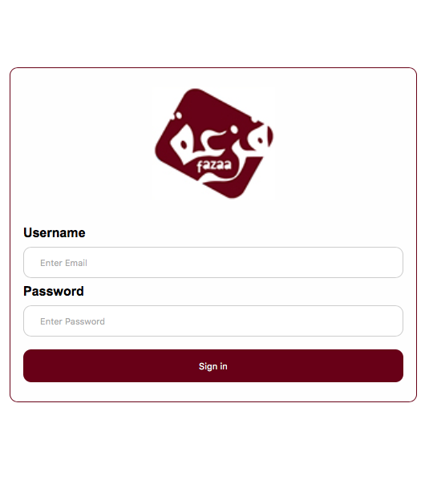
Platform Demo

Slide 14

References
Fazaa official website
Existing fazaa online system

Slide 15
Thank you for listening

